Slide 1


Nutan Maharashtra Vidya Prasarak Mandal’s
NUTAN COLLEGE OF ENGINEERING AND RESEARCH
Under Administrative Support of Pimpri Chinchwad Education Trust
ISO 21001:2018 EOMS Certified
Final Presentation
Presentation on
AI FOR LEGAL CASE OUTCOME PREDICTION
By
Amay Lohar (B14)
Nikhil Raghuwanshi (B36)
Shital Kalekar (B62)
Shraddha Dhanwate (B76)
Under the guidance of
Dr. Prashant Ahire
Dr. Priyanka Patil
Department of CSE-Artificial Intelligence

Slide 2
Nutan Maharashtra Vidya Prasarak Mandal’s
NUTAN COLLEGE OF ENGINEERING AND RESEARCH
Under Administrative Support of Pimpri Chinchwad Education Trust
ISO 21001:2018 EOMS Certified
Project Phase- IV
Final Presentation
Introduction
The Indian judicial system processes millions of cases annually, documented in lengthy, unstructured PDFs.
Manual legal research and outcome prediction are highly time-consuming and cognitively demanding.
Our Solution: A production-grade, end-to-end Legal AI Engine designed to read complex court judgments, automatically translate outdated laws, and predict appellate outcomes.
Core Technology: Advanced domain-specific Transformers (InLegalBERT), augmented by Dynamic Statutory Translation and Explainable AI (SHAP).

Slide 3
Nutan Maharashtra Vidya Prasarak Mandal’s
NUTAN COLLEGE OF ENGINEERING AND RESEARCH
Under Administrative Support of Pimpri Chinchwad Education Trust
ISO 21001:2018 EOMS Certified
Final Presentation
Review - IV
Problem Statement
The legal system suffers from a massive backlog, with judgments spanning hundreds of unstructured pages. Applying standard AI introduces three major roadblocks:
India's judiciary has over 5 crore pending cases across the Supreme Court, 25 High Courts, and 700+ District Courts — one of the largest judicial backlogs globally.
Court judgments are lengthy, unstructured PDFs (20–100+ pages) written in complex legal English, making manual analysis extremely time-consuming.
No domain-specific AI tool exists for the Indian legal system — generic LLMs like GPT lack understanding of Indian statutes, FIR terminology, and case law structures.
India's 2023 transition from the Indian Penal Code (IPC, 1860) to the Bharatiya Nyaya Sanhita (BNS) has created widespread confusion among legal professionals due to renumbered sections.
Lawyers and litigants lack predictive insight into case outcomes, leading to uncertainty, wasted effort, and delayed justice.

Slide 4
Nutan Maharashtra Vidya Prasarak Mandal’s
NUTAN COLLEGE OF ENGINEERING AND RESEARCH
Under Administrative Support of Pimpri Chinchwad Education Trust
ISO 21001:2018 EOMS Certified
Final Presentation
Review - IV
Problem Solution
Structure-Aware Chunking: Engineered a custom Regex pipeline to specifically isolate 'Facts' and 'Arguments' sections from unstructured judgments, bypassing BERT's 512-token limit and feeding only legally relevant text.
Dynamic JSON Middleware: Built an automated IPC-to-BNS translation layer (80+ mappings in bns_mapping.json) that seamlessly converts legacy IPC section references to modern BNS equivalents before AI inference.
Dual-Inference Pipeline: Two separately fine-tuned InLegalBERT models — Module B classifies Jurisdiction (Civil / Criminal / Constitutional) and Module C predicts Appellate Outcome (Allowed / Dismissed) — achieving 85.2% accuracy.
Role-Based Access Control: Four user roles (Student, Lawyer, Judge, Admin) with Supabase authentication and Row Level Security, ensuring each user only accesses authorized modules and their own data.
Cloud-Backed Audit Trail: Every prediction is automatically logged to a PostgreSQL database with timestamps, confidence scores, and file references for full traceability.

Slide 5
Nutan Maharashtra Vidya Prasarak Mandal’s
NUTAN COLLEGE OF ENGINEERING AND RESEARCH
Under Administrative Support of Pimpri Chinchwad Education Trust
ISO 21001:2018 EOMS Certified
Final Presentation
Review - IV
Objectives
Objective 1: Curate a real-world corpus of Indian judicial data from Supreme Court and High Court appellate records.
Objective 2: Engineer a robust NLP pipeline using PyMuPDF and Structure-Aware Chunking to extract core case facts, arguments, and judgment sections from raw PDFs.
Objective 3: Implement a dynamic IPC-to-BNS translation layer with 80+ statutory section mappings to bridge legacy and modern penal codes.
Objective 4: Train and deploy a dual-inference InLegalBERT transformer pipeline — one model for jurisdiction classification (3-class) and one for outcome prediction (binary).
Objective 5: Develop a secure, role-based SaaS dashboard (Streamlit + Supabase) with authenticated access for Students, Lawyers, Judges, and Admins.

Slide 6
Nutan Maharashtra Vidya Prasarak Mandal’s
NUTAN COLLEGE OF ENGINEERING AND RESEARCH
Under Administrative Support of Pimpri Chinchwad Education Trust
ISO 21001:2018 EOMS Certified
Final Presentation
Review - IV
Methodology/ Workflow
Data Extraction: Extracted raw text from legal judgment PDFs using PyMuPDF (fitz), handling multi-page documents with complex formatting.
Text Preprocessing: Applied custom Regex patterns to remove irrelevant metadata — CORAM, HEADNOTE, administrative headers — retaining only the substantive legal content.
Dynamic Translation: Passed cleaned text through a JSON-based IPC-to-BNS middleware that replaces legacy penal code references with their modern BNS equivalents (80+ mappings).
Structure-Aware Chunking: Isolated the three key sections — 'Facts', 'Arguments', and 'Judgment' — using domain-specific Regex patterns to feed the AI only pure, contextually relevant text.
Dual-Model Inference: Processed extracted chunks through two separately fine-tuned InLegalBERT models — Module B for Jurisdiction classification (3-class) and Module C for Outcome prediction (binary).
Secure SaaS Deployment: Wrapped the entire pipeline in a Streamlit dashboard with Supabase PostgreSQL backend for role-based authentication, encrypted data storage, and prediction audit logging.

Slide 7
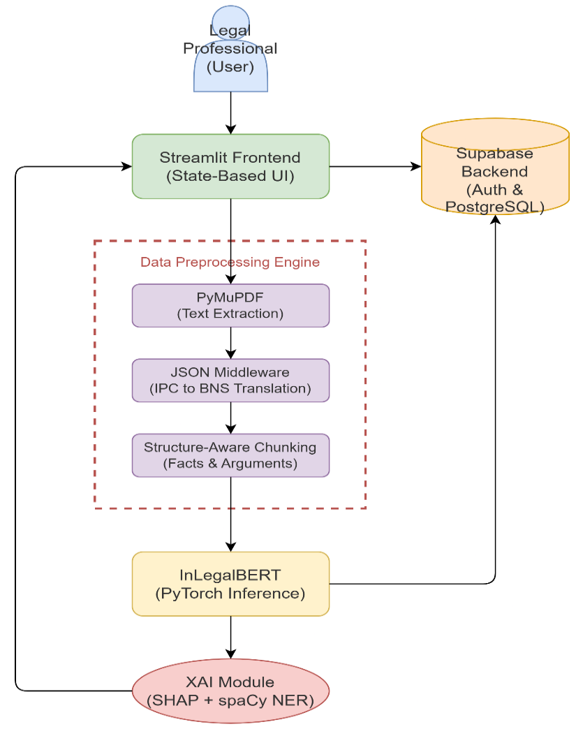
Nutan Maharashtra Vidya Prasarak Mandal’s
NUTAN COLLEGE OF ENGINEERING AND RESEARCH
Under Administrative Support of Pimpri Chinchwad Education Trust
ISO 21001:2018 EOMS Certified
Final Presentation
Review - IV
System Architecture

Slide 8
Nutan Maharashtra Vidya Prasarak Mandal’s
NUTAN COLLEGE OF ENGINEERING AND RESEARCH
Under Administrative Support of Pimpri Chinchwad Education Trust
ISO 21001:2018 EOMS Certified
Final Presentation
Review - IV
Literature Survey
Sr.No | Title | Year | Study Type/ Approach | Objective | Limitations
1 | The Case for AI- Powered Legal Aid | 2023 | Analytical and qualitative study examining the role of AI in enhancing access to justice. | To analyze how AI-powered legal aid tools like MyOpenCourt can improve access to justice legal processes. | Limited empirical validation, privacy and security risks, digital divide issues, and concerns over unauthorized practice of law.
2 | AI-powered decisionmaking in facilitating insurance claim dispute resolution | 2023 | Analytical and conceptual study using comparative analysis to evaluate AI’s role in transforming the legal sector. | To explore how AI applications can enhance judicial efficiency, accuracy in the legal system. | Challenges include ethical issues, lack of legal framework, data privacy concerns, and limited technological infrastructure.
3 | Predictive Modelling in Legal DecisionMaking: Leveraging Machine Learning for Forecasting Legal Outcomes | 2024 | Descriptive and analytical study examining the integration of AI in the legal sector. | To highlight how AI enhances efficiency, transparency, and decision-making in law. | Ethical concerns, data bias, lack of regulation, and dependency on technology.
4 | Predictive Justice in Indian Courts: Machine Learning Approaches to Case Outcome Forecasting | 2024 | Sophisticated, multi-layered machine learning,Deep Neural Networks, SVM,NLP predictive legal analytics framework tailored to the Indian judicial system. | Develop a model for predicting judicial outcomes,analyze factors influencing judicial decisionmaking in the Indian context | Limited historical data availability, challenges in representing contextual nuance, and potential algorithmic biases.

Slide 9
Nutan Maharashtra Vidya Prasarak Mandal’s
NUTAN COLLEGE OF ENGINEERING AND RESEARCH
Under Administrative Support of Pimpri Chinchwad Education Trust
ISO 21001:2018 EOMS Certified
Final Presentation
Review - IV
5 | Ai in legal analytics : balancing efficiency, accuracy, and ethics in contract and predictive analysis . | 2023 | Analytical essay/review discussing the role, benefits, challenges of AI in Legal Analytics, focusing on contract and predictive analysis. | Analyze how AI revolutionized the legal system, discussing shortcomings of AI systems, recommending their integration into legal work. | Challenges with accuracy and reliability , bias and fairness from training data , issues of professional integrity/technological competence , and data privacy concerns.
6 | Artificial intelligence as evidence | 2024 | Analysis of the legal and technical issues governing the admissibility of Artificial Intelligence (AI) evidence in civil and criminal trials under the Federal Rules of Evidence. | Provide a practical overview and a systematic framework for lawyers and judges to evaluate the validity and reliability of AI evidence | Bias (in data, programming, and human interpretation), lack of robust testing for validity and reliability, function creep, lack of transparency/explainability, lack of accountability, and lack of resilience
7 | Agentic AI-Driven Process Optimization and Cost Reduction in Legal Services Using DeepSeek | 2025 | Development and empirical evaluation of LegalMind, a novel agentic AI framework leveraging the DeepSeek R1 LLM for intelligent legal process automation cost reduction. | Design implement a transformer-based agentic AI framework to perform human-like legal reasoning, enable continuous learning, | Struggles with complex legal reasoning and ethical dilemmas, data sensitivity and privacy concerns, challenges with cross-jurisdictional adaptability, and high computational resource requirements for smaller firms.
8 | Outcome Prediction in the Practice of Law | 2020 | Analytical article examining the traditional tools and new data science/AI approaches | Examine traditional legal prediction tools and their limitations, describe how new data-science enhance legal outcome prediction. | Lack of key empirical data (e.g., settlement data and detailed facts in published opinions) and extra-legal considerations make accurate prediction difficult, even for AI.

Slide 10
Nutan Maharashtra Vidya Prasarak Mandal’s
NUTAN COLLEGE OF ENGINEERING AND RESEARCH
Under Administrative Support of Pimpri Chinchwad Education Trust
ISO 21001:2018 EOMS Certified
Final Presentation
Review - IV
9 | AI for legal justice | 2025 | Analytical review discussing the need for and the various components of a comprehensive ethical framework for the utilization of ai in the judicial | Propose a comprehensive, multi-layered ethical framework for the use of AI in the judicial system that safeguards the rule of law, constitutional values. | The fundamental nature of the study is a theoretical proposal of an ethical framework, so it does not contain empirical/technical limitations, but addresses the risks inherent to AI in law
10 | Legal Judgment Prediction (LJP) Amid the Advent of Autonomous AI Legal Reasoning | 2023 | Analytical review investigating the risks and benefits of Algorithmic Decision Systems at the intersection of AI proposing a regulatory framework. | Critically examine ADS risks and benefits to propose a comprehensive regulatory and ethical framework. | Algorithmic opacity, difficulty mitigating bias, and challenges from the dynamic nature of predictive systems
11 | Legal & Ethical Implications of Predictive Digital Techniques in the Judicial Criminal Proceedings | 2025 | Analytical review focused on identifying and mitigating the legal and ethical challenges associated with the adoption of AI in the justice system to ensure compliance with the Rule of Law. | Analyze the legal, ethical, and societal challenges posed by AI in the justice system (e.g., judicial and public administration) and propose solutions that respect the fundamental rights and the Rule of Law. | Algorithmic bias/fairness, lack of transparency (black box), issues of accountability, potential for "robot judges" or a status quo effect (mechanical application of law), and concerns about the reliability of AI outputs.
12 | Artificial intelligence in the courtroom : The delivery of JUSTICE IN THE AGE OF MACHINE LEARNING | 2023 | a novel 'Predictive Justice Score' (PJS) metric to measure the predictive capacity of machine learning (ML) models in judicial decision-making, along with a discussion of ethical and legal concerns. | Propose a new metric, the Predictive Justice Score (PJS), for evaluating the capability of ML algorithms to predict judicial decisions and discuss the related legal and ethical challenges. | Lack of a definitive 'Ground Truth' in judicial decisions for comparison, susceptibility to data bias and algorithmic opacity, and the challenge of incorporating the nuance of constitutional and legal interpretation into quantitative metrics like the PJS.

Slide 11
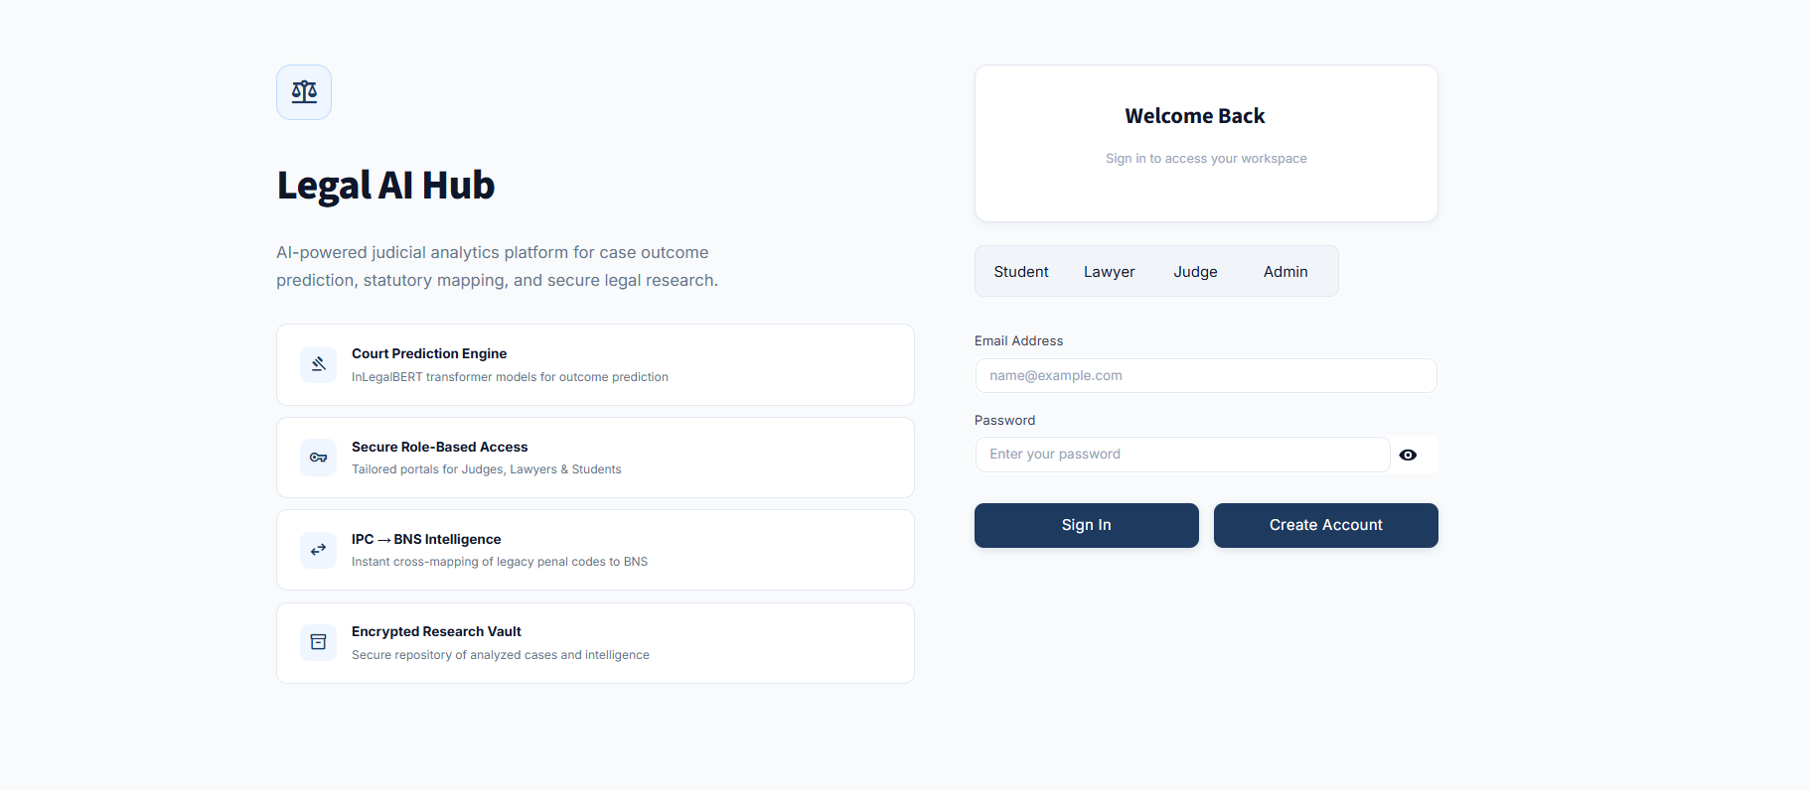
Nutan Maharashtra Vidya Prasarak Mandal’s
NUTAN COLLEGE OF ENGINEERING AND RESEARCH
Under Administrative Support of Pimpri Chinchwad Education Trust
ISO 21001:2018 EOMS Certified
Final Presentation
Review - IV
Implementation of Work / Result

Slide 12
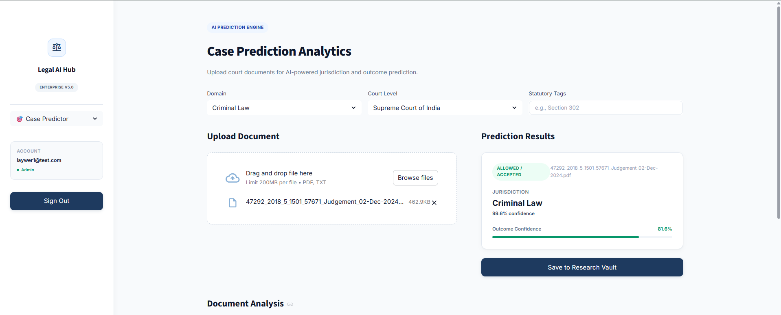
Nutan Maharashtra Vidya Prasarak Mandal’s
NUTAN COLLEGE OF ENGINEERING AND RESEARCH
Under Administrative Support of Pimpri Chinchwad Education Trust
ISO 21001:2018 EOMS Certified
Final Presentation
Review - IV
Implementation of Work / Result

Slide 13
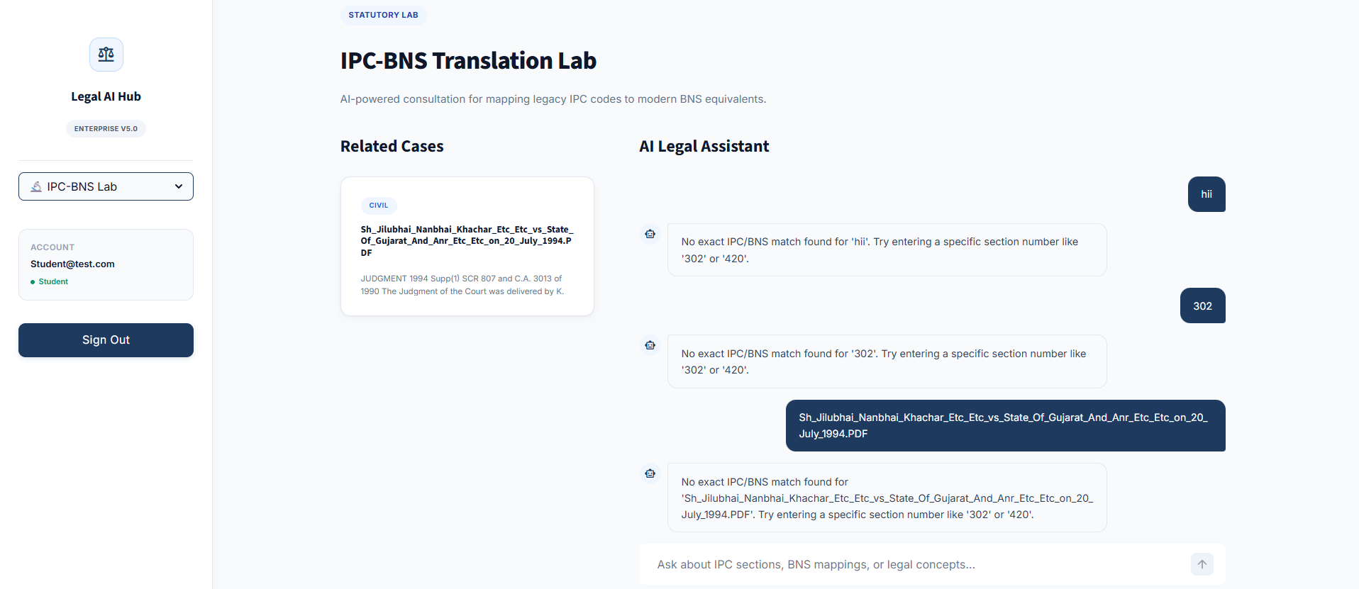
Nutan Maharashtra Vidya Prasarak Mandal’s
NUTAN COLLEGE OF ENGINEERING AND RESEARCH
Under Administrative Support of Pimpri Chinchwad Education Trust
ISO 21001:2018 EOMS Certified
Final Presentation
Review - IV
Implementation of Work / Result

Slide 14
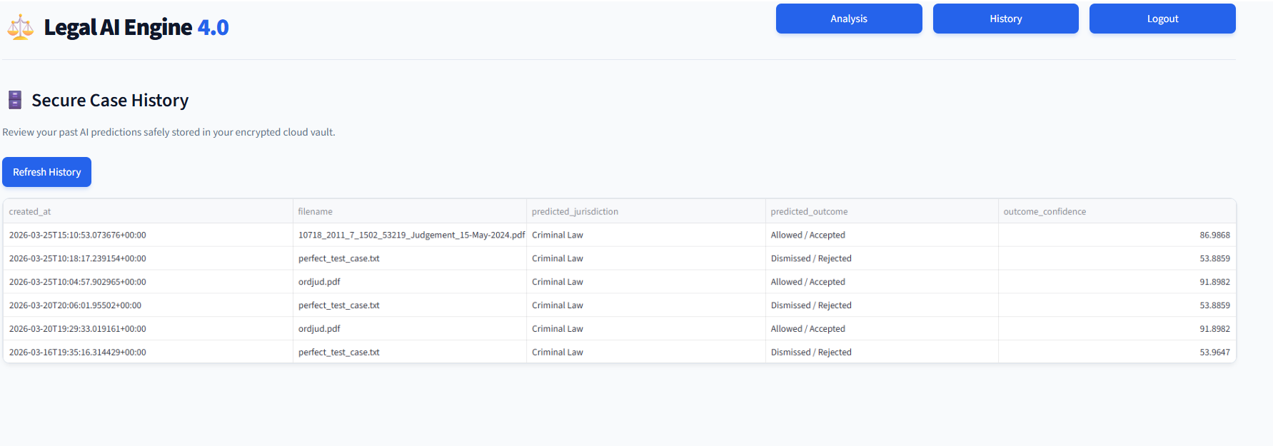
Nutan Maharashtra Vidya Prasarak Mandal’s
NUTAN COLLEGE OF ENGINEERING AND RESEARCH
Under Administrative Support of Pimpri Chinchwad Education Trust
ISO 21001:2018 EOMS Certified
Final Presentation
Review - IV
Implementation of Work / Result

Slide 15
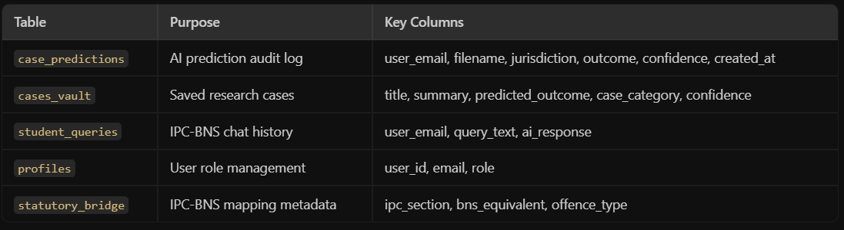
Nutan Maharashtra Vidya Prasarak Mandal’s
NUTAN COLLEGE OF ENGINEERING AND RESEARCH
Under Administrative Support of Pimpri Chinchwad Education Trust
ISO 21001:2018 EOMS Certified
Final Presentation
Review - IV
Title: Database Design (Supabase PostgreSQL)
Tables:
Security Features:
Row Level Security (RLS) enabled on all tables
Auto-profile creation via PostgreSQL trigger on user signup
Performance indexes on user_email and case_category
Supabase Auth for encrypted authentication

Slide 16
Nutan Maharashtra Vidya Prasarak Mandal’s
NUTAN COLLEGE OF ENGINEERING AND RESEARCH
Under Administrative Support of Pimpri Chinchwad Education Trust
ISO 21001:2018 EOMS Certified
Final Presentation
Review - IV
Conclusion
We successfully engineered a production-ready Legal AI platform that parses unstructured court judgment PDFs, preprocesses them through a custom NLP pipeline, and predicts appellate outcomes with 85.2% accuracy using fine-tuned InLegalBERT.
Our dual-model architecture (Module B for Jurisdiction, Module C for Outcome) provides comprehensive case analysis — classifying domain and forecasting decisions in a single workflow.
The IPC-to-BNS translation engine with 80+ statutory mappings addresses a real, urgent need created by India's 2023 penal code transition — making it immediately useful for legal professionals.
Role-based access control with Supabase authentication ensures that Students, Lawyers, Judges, and Admins each have a secure, tailored experience.
The project demonstrates that domain-specific AI models (InLegalBERT) significantly outperform generic approaches (+23% over baseline), proving the value of specialized NLP in the legal domain.

Slide 17
Nutan Maharashtra Vidya Prasarak Mandal’s
NUTAN COLLEGE OF ENGINEERING AND RESEARCH
Under Administrative Support of Pimpri Chinchwad Education Trust
ISO 21001:2018 EOMS Certified
Final Presentation
Review - IV
Future Scope
Generative AI Integration: Implementing Large Language Models (LLMs) to automatically generate plain-English summaries of complex court judgments alongside the AI predictions — making outputs accessible to non-legal users.
Explainable AI (SHAP): Integrating SHAP (SHapley Additive exPlanations) to generate visual heatmaps highlighting the exact words and phrases that influenced the AI's prediction — increasing transparency and trust.
Multilingual Support: Expanding the NLP pipeline to process court documents in regional languages — Hindi, Marathi, and Tamil — using multilingual transformer models.
Sentence & Penalty Prediction: Extending the model to predict not just outcomes but also estimated imprisonment duration and settlement amounts for civil cases.
Frontend Migration: Rebuilding the Streamlit UI in React.js or Next.js to provide a production-grade, mobile-responsive application for practicing lawyers on the go.
REST API Deployment: Exposing the prediction models as RESTful APIs so third-party legal-tech platforms can integrate our predictions into their workflows.

Slide 18
Nutan Maharashtra Vidya Prasarak Mandal’s
NUTAN COLLEGE OF ENGINEERING AND RESEARCH
Under Administrative Support of Pimpri Chinchwad Education Trust
ISO 21001:2018 EOMS Certified
Final Presentation
Review - IV
References
[1] Chalkidis, I., Fergadiotis, M., Malakasiotis, P., Hamel, J., & Androutsopoulos, I. (2020). LEGAL-BERT: “Preparing the Muppets for Court”. In Findings of the Association for Computational Linguistics: EMNLP 2020, pages 2598–2612, Online. Association for Computational Linguistics.
[2] Cao, L., Wang, Z., Xiao, C., & Sun, J. (2024). PILOT: Legal Case Outcome Prediction with Case Law. In Proceedings of the 2024 Conference of the North American Chapter of the Association for Computational Linguistics: Human Language Technologies (Volume 1: Long Papers), pages 609–621, Mexico City, Mexico. Association for Computational
Linguistics.
[3] Sharma, S., Shandilya, R., & Sharma, S. (2021). Predicting Indian Supreme Court Judgments, Decisions, Or Appeals. arXiv preprint arXiv:2110.09251.
[4] Alghazzawi, D., Alghamdi, R., Alotaibi, A., & El-Din, A. M. B. (2022). Efficient Prediction of Court Judgments Using an LSTM+CNN Neural Network Model with an Optimal Feature Set. Mathematics, 10(5), 683.
[5] Schafer, B., Middelton, C., & Schafer, R. (2023). Explainable AI and Law: An Evidential Survey. Artificial Intelligence and Law, 31(4), 589-623.

Slide 19
Nutan Maharashtra Vidya Prasarak Mandal’s
NUTAN COLLEGE OF ENGINEERING AND RESEARCH
Under Administrative Support of Pimpri Chinchwad Education Trust
ISO 21001:2018 EOMS Certified
Final Presentation
Review - IV
References
[6] Malik, V., Sanjay, R., Nigam, S. K., Ghosh, K., Guha, A. K., Bhattacharya, A., & Modi, A. (2021). ILDC for CJPE: Indian Legal Documents Corpus for Court Judgment Prediction and Explanation. In Proceedings of the 59th Annual Meeting of the Association for Computational Linguistics (ACL), pages 4046–4062.
[7] Nigam, S. K., Kumar, A., & Bhattacharya, A. (2024). NyayaAnumana & INLegalLlama: The Largest Indian Legal Judgment Prediction Dataset. arXiv preprint arXiv:2412.08385.
[8] Sahoo, S., Pattnaik, M., & Das, A. (2023). A Comprehensive Analysis of Indian Legal Documents Summarization Techniques. Neural Computing and Applications, 35(21), 14611–14631.
[9] Katz, D. M., Bommarito, M. J., & Blackman, J. (2017). A General Approach for Predicting the Behavior of the Supreme Court of the United States. PLOS ONE, 12(4), e0174185.
[10] Liu, Y., Zhang, W., Zhang, M., Ding, X., & Fan, X. (2022). Legal Text Recognition Using LSTM-CRF Deep Learning Model. Computational Intelligence and Neuroscience, 2022, 1–10.
[11] Savelka, J., & Ashley, K. (2023). Leveraging Large Language Models for Legal Text Prediction. Artificial Intelligence and Law, 32(1), 1-25.
[12] Ashley, K. D. (2017). Artificial Intelligence and Legal Analytics: New Tools for Law Practice in the Digital Age. Cambridge University Press.

Slide 20
Nutan Maharashtra Vidya Prasarak Mandal’s
NUTAN COLLEGE OF ENGINEERING AND RESEARCH
Under Administrative Support of Pimpri Chinchwad Education Trust
ISO 21001:2018 EOMS Certified
Final Presentation
Review - IV
References
[13] R. Jaegers, “A Novel Approach to Legal Text Summarization with Deep Reinforcement Learning,” Journal of Political Science and International Relations Studies, vol. 7, no. 1, pp. 1–11, 2024.
[14] P. de Souza, L. Chalkidis, and V. Simaki, “Topic Modelling of Legal Documents via LEGAL-BERT,” in 2022 IEEE International Conference on Big Data (Big Data), 2022, pp. 4465–4474.
[15] S. Tuladhar, S. Zuk, and M. Shardlow, “BERT-based Classification of US Supreme Court Decisions,” in Proceedings of the 14th Interna tional Conference on Recent Advances in Natural Language Processing (RANLP 2023), Varna, Bulgaria: INCOMA Ltd., 2023, pp. 1195–1205.
[16] Anonymous, “A Hybrid Model for Legal Entity Recognition using Legal-BERT and Semantic Filtering,” arXiv preprint arXiv:2410.08521v1, 2024.
[17] P. Katsikouli, R. Sorge, and N. Perra, “Machine Learning and Asylum Adjudications: From Analysis of Variations to Outcome Predictions,” in 2022 IEEE International Conference on Big Data (Big Data), 2022, pp. 4786–4795.
[18] M. B. Kmainasi, S. Kmainasi, and O. El Mounadi, “Can Large Language Models Predict the Outcome of Judicial Decisions?,” arXiv preprint arXiv:2501.09768, 2025.
[19] D. L. Katz, M. J. Bommarito, and J. Blackman, “A time-evolving random forest classifier for judicial prediction,” PLOS ONE, vol. 12, no. 4, p. e0174185, 2017.

Slide 21
Nutan Maharashtra Vidya Prasarak Mandal’s
NUTAN COLLEGE OF ENGINEERING AND RESEARCH
Under Administrative Support of Pimpri Chinchwad Education Trust
ISO 21001:2018 EOMS Certified
Final Presentation
Review - IV
References
[20] F. Ariai and G. Demartini, “Natural Language Processing for the Legal Domain: A Survey,” arXiv preprint arXiv:2410.21306, 2024.
[21] D. M. Katz, M. J. Bommarito II, and J. Blackman, “A general approach for predicting the behavior of the Supreme Court of the United States,” PLOS ONE, vol. 12, no. 4, 2017.
[22] N. Aletras, D. Tsarapatsanis, D. Preot¸iuc-Pietro, and V. Lampos, “Pre dicting judicial decisions of the European Court of Human Rights,” PeerJ Computer Science, vol. 2, 2016.
[23] V. Malik et al., “ILDC for CJPE: Indian Legal Documents Corpus for Court Judgment Prediction and Explanation,” in Proceedings of ACL IJCNLP, 2021, pp. 4046–4062.
[24] Z. Zhong, C. Xiao, C. Tu, T. Zhang, Z. Liu, and M. Sun, “Legal Judg ment Prediction via Topological Learning,” in Proceedings of EMNLP, 2018.
[25] Y. Feng, Y. Qin, X. Wang, and J. Chen, “Legal Judgment Prediction via Event Extraction,” in Proceedings of COLING, 2022.
[26] J. ˇ Savelka and K. Ashley, “Leveraging Large Language Models for Legal Text Prediction,” Artificial Intelligence and Law, 2023.
[27] S. K. Nigam et al., “NyayaAnumana & INLegalLlama: The Largest Indian Legal Judgment Prediction Dataset,” arXiv preprint arXiv:2412.08385, 2024.
[28] S. K. Nigam et al., “TathyaNyaya and FactLegalLlama: Advancing Factual Judgment Prediction,” arXiv preprint arXiv:2504.04737, 2025

